Slide 1
Board Games
Aline Barbiaux – Manon Libert

Slide 2
How board games …
Were invented
Have various types
Are used in education
Turned into a passion
Got computerized

Slide 3
Invention & History

Slide 4
Various types

Slide 5
What about education ?

Slide 6
Passionate people
Poker WSOP
Club
board games cafés
Toy Library

Slide 7

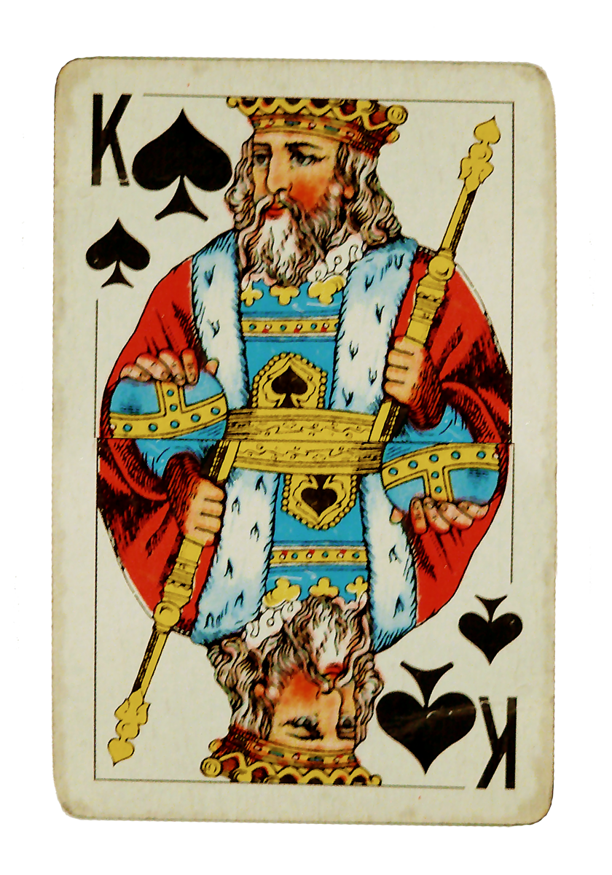
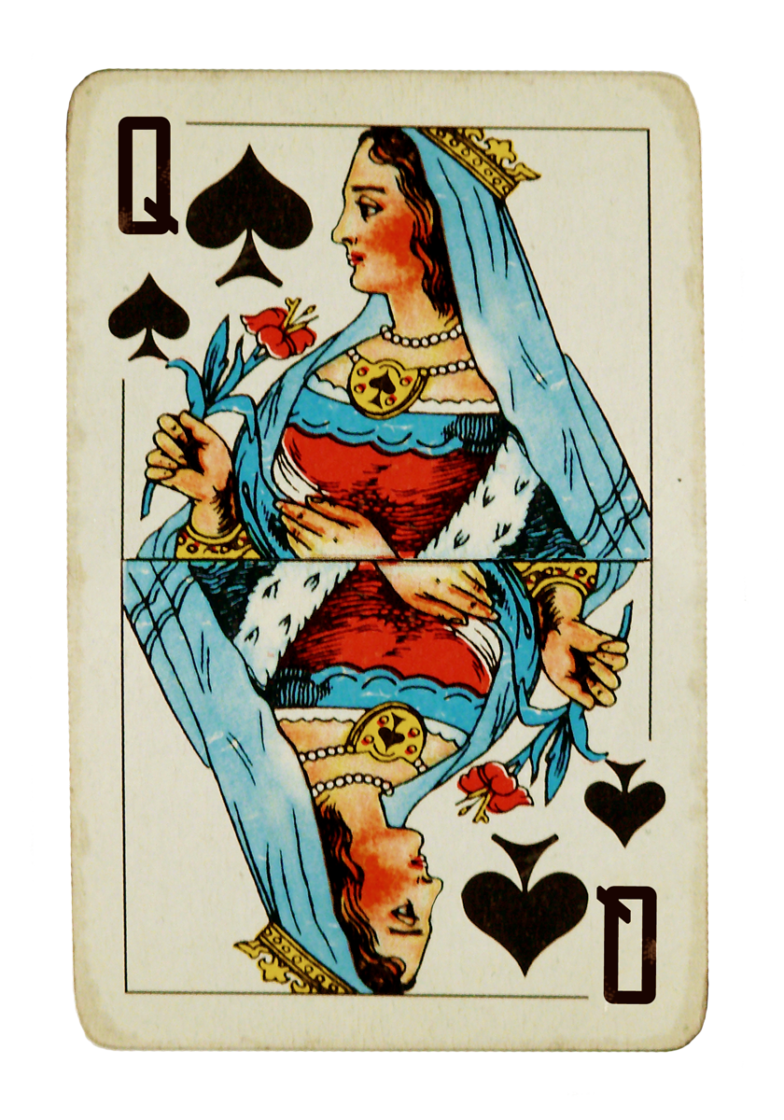


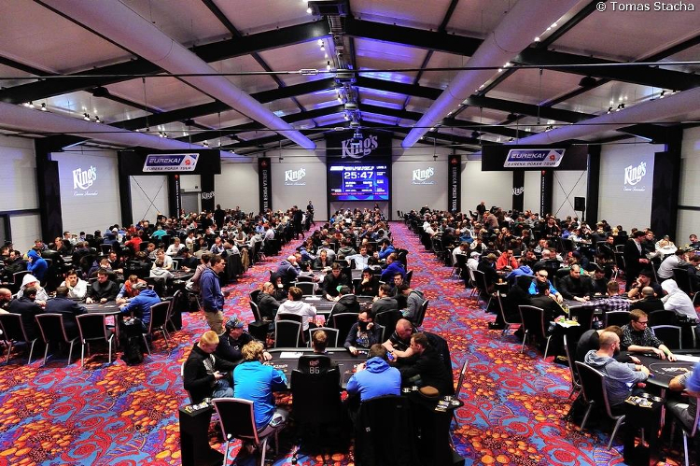

Passionate people - Poker

Slide 8
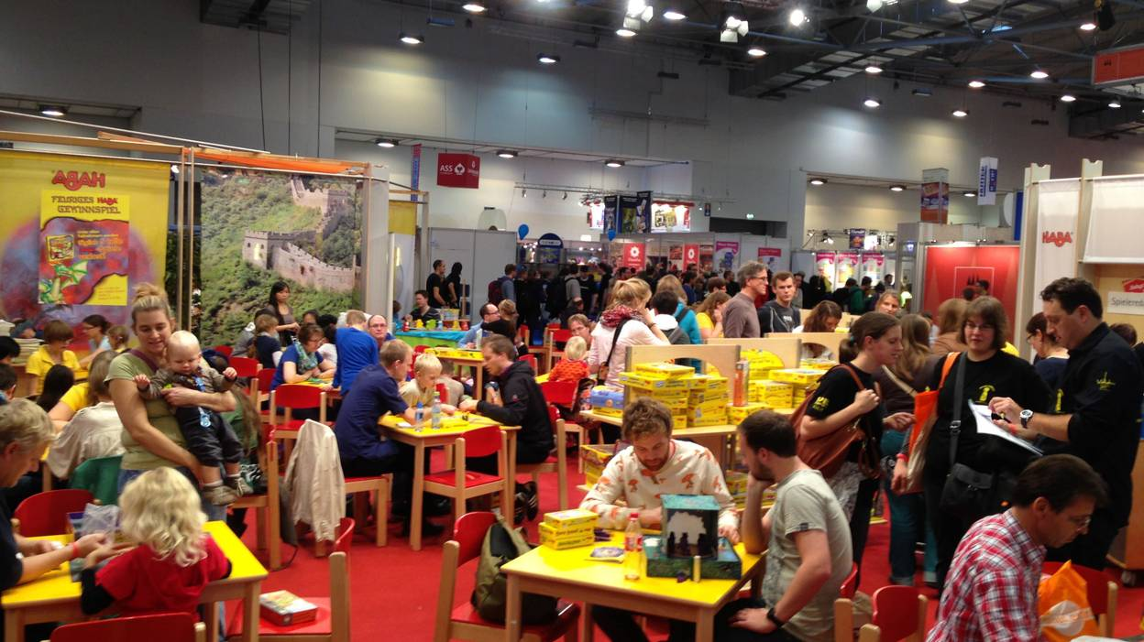
Passionate people - clubs
Often small associations
Outside performance
Essen, worldwide capital of board games

Slide 9
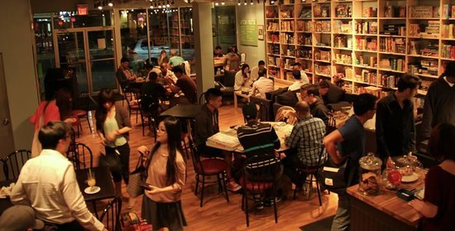
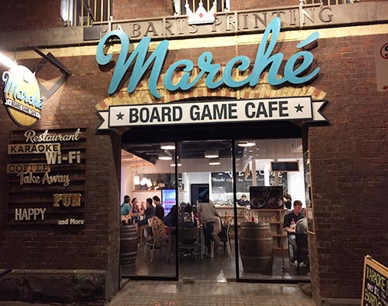
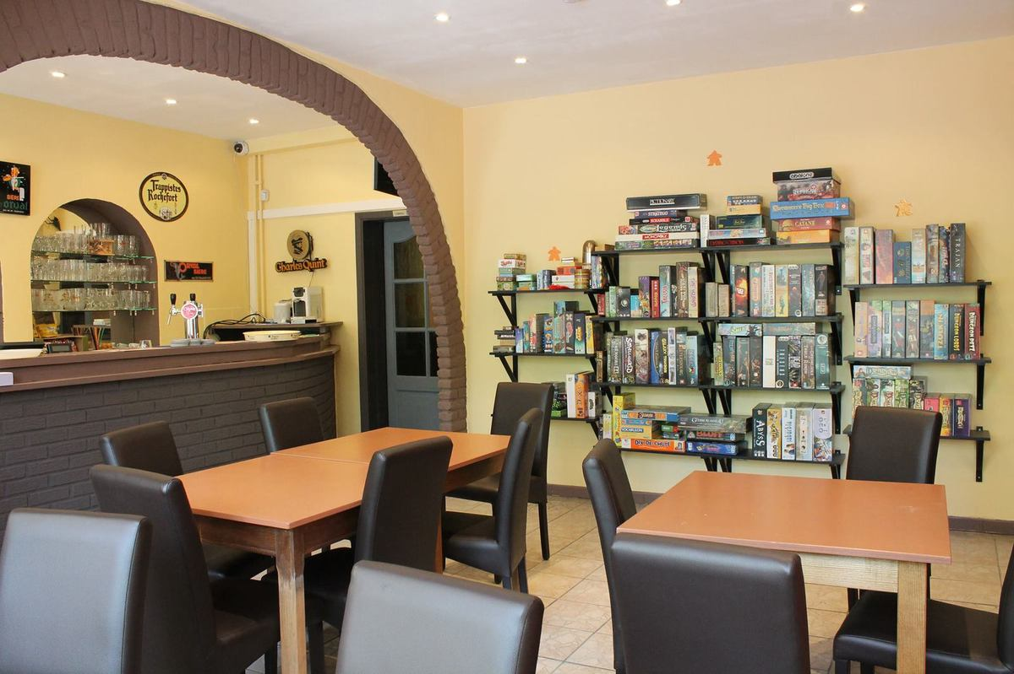
Passionate people – Bord Game Café

Slide 10
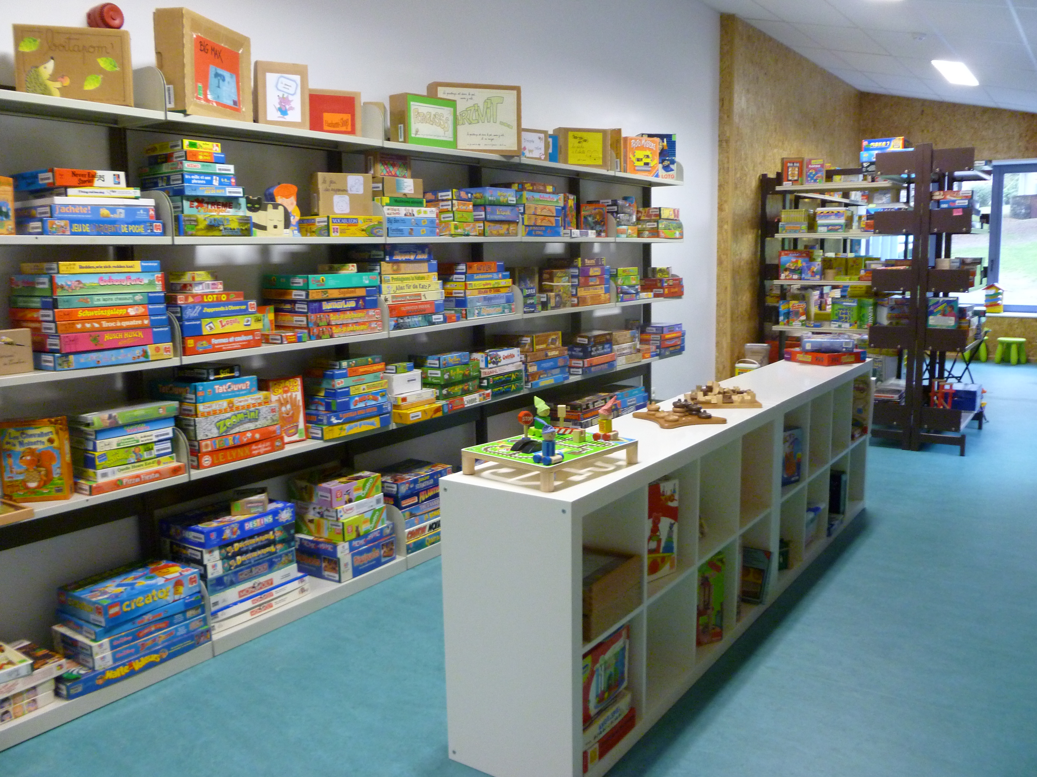
Passionate people – Toy library

Slide 11
Nerd Alert !

